Slide 1
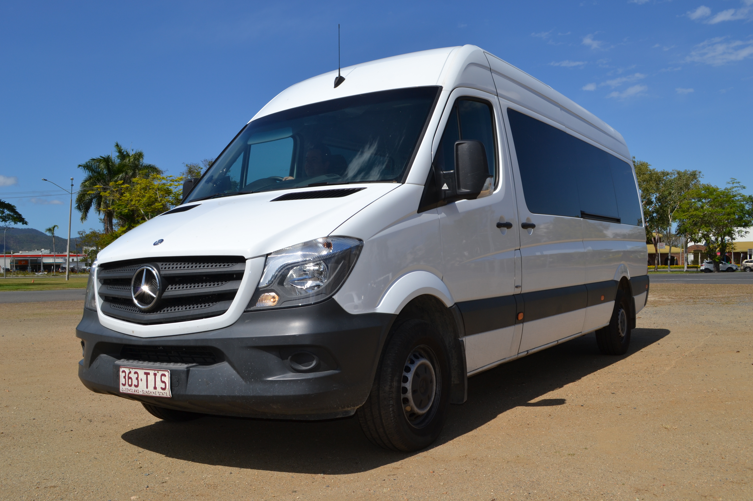
CentacareCQ TRANSPORT

Slide 2
Centacare Transport
Affordable, safe and convenient transport options
Door-to-door service available to the aged and those living with disability
Available for health appointments, shopping and social outings
Group bookings available
Modern cars and buses are built for comfort and modified to allow for easy access, wheelchairs, and extra standing height
All drivers qualified and trained
1800 number for ease of booking
Operates 7am to 5pm Monday to Friday
1 carer travels free of charge

Slide 3
The Transport Process
Client contacts Centacare on 1800 number
Referral is made to either M A C or CSO
Assessment is made via R A S or CSO
Referral back to Centacare for documentation
Transport booking processing commences

Slide 4
Our Transport System

Slide 5
Scheduling

Slide 6
Our Fees
 | Transport per each way trip (1 Carer is free)
 | Distance | CHSP & QCCS Funded (formerly HACC) |  | Private Client
 |  | Full Pension | Part Pension & Self-funded retirees
 | 1 – 10 kilometres | $6 | $8 | $10
 | 11-25 kilometres | $10 | $12 | $40
 | 25-50 kilometres | $20 | $24 | $60
 | 51 – 100 kilometres | $30 | $40 | $80
 | 101 – 200 kilometres | $40 | $48 | $150
 | Over 200km | By agreement

Slide 7
Brokerage of Scheduling Service
Client requires transport
Client contacts provider
Provider contacts Centacare
Centacare contacts client
Trip scheduled
Centacare sends invoice for trip to provider
Trip provided ☺

